Slide 1
UART

Slide 2
The UART: What it is and how it works
The Universal Asynchronous Receiver/Transmitter (UART) controller is the key component of the serial communications subsystem of a computer. The UART takes bytes of data and transmits the individual bits in a sequential fashion. At the destination, a second UART re-assembles the bits into complete bytes.

Slide 3
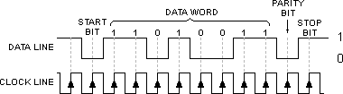
Asynchronous Serial Data Frame

Slide 4
Data frame?
Data frame is defined as adding a parity bit between the last bit of the word and the first stop bit, this used as a data integrity check.

Slide 5
Types of parity bits
the mark parity bit is always set at a logical 1.
the space parity bit is always set at a logical 0.
the even parity bit is set to logical 1 by counting the number of 1's bits in the complete envelope and determining if the result is even.
the odd parity bit, the parity bit is set to logical 1 if the number of 1's bits in the complete envelope is odd.
you don't have to use parity bits, thus elliminating 1 bit in each frame, this is often reffered to as non parity bit frame.

Slide 6
BIT RATES
BIT RATE is the bit rate at which the the data is transmitted
Faster speeds are all based on the 300 bps rate, you merely double the preceding rate, so the rates are as follows, 600, 1200, 2400, 4800, 9600, 19200 and 38400 which is the fastest speed supported by todays BIOSs.
By bypassing the BIOS all together and controlling the hardware directly, you can obtain speeds up to 155200 bps and greater but with the venue of new intelligent ports you can obtain these new speeds without compromising on control.

Slide 7
TYPES
There are two primary forms of serial transmission: Synchronous and Asynchronous. Depending on the modes that are supported by the hardware, the name of the communication sub-system will usually include a A if it supports Asynchronous communications, and a S if it supports Synchronous communications. Both forms are described below.
Some common acronyms are:
UART Universal Asynchronous Receiver/Transmitter
USART Universal Synchronous-Asynchronous Receiver/Transmitter

Slide 8
REGISTERS
Line Control Register (U0LCR & U1LCR)
Divisor Latch Register(U0DLL,U0DLM &U1DLL,U1DLM)
Transmit Buffer Register(U0THR & U1THR)
Receive Buffer Register(U0RBR & U1RBR)
Line Status Register(U0LSR & U1LSR)
Fractional Divisor Register(U0LDR & U1LDR)

Slide 9
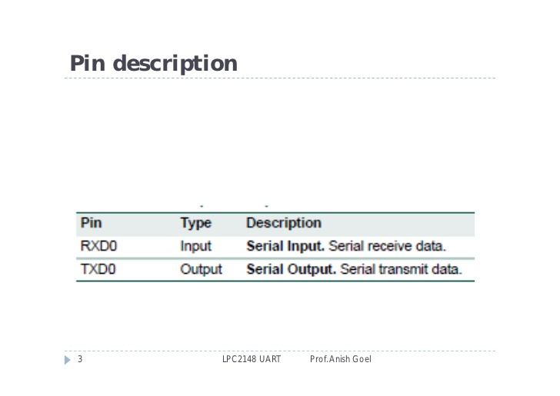

Slide 10
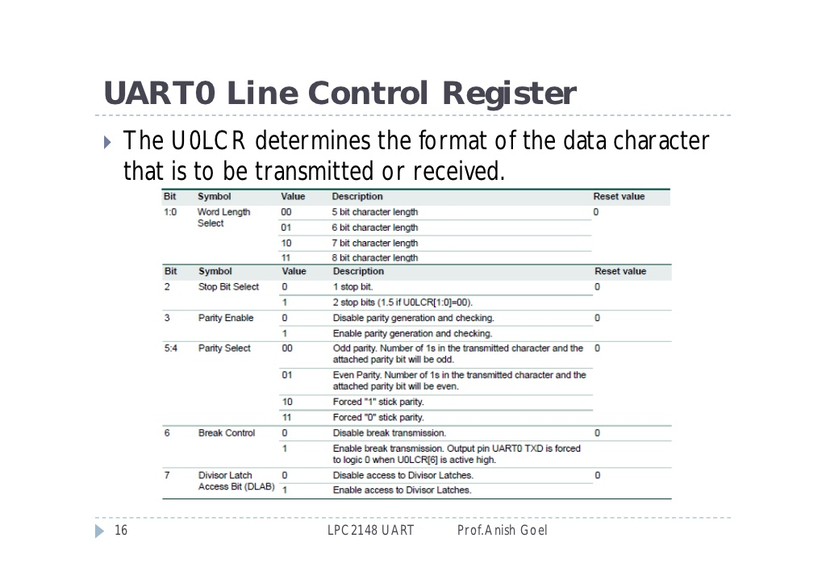

Slide 11
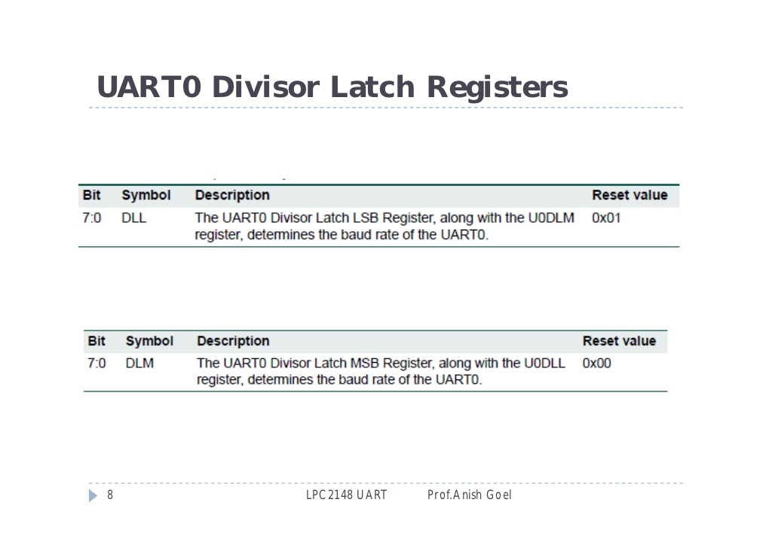

Slide 12
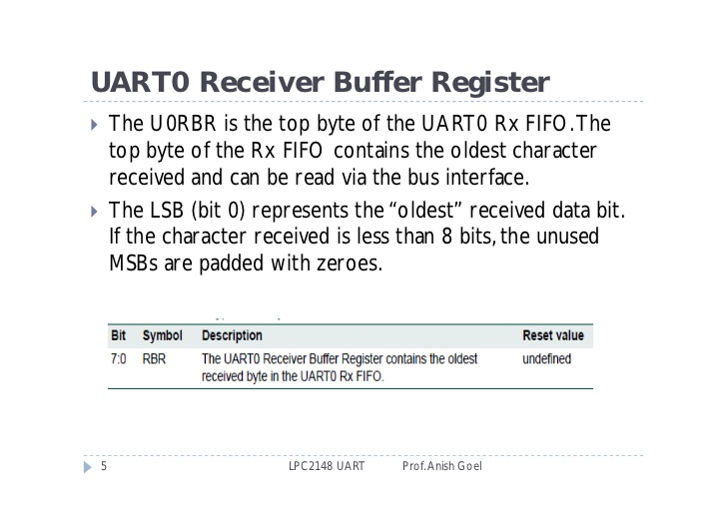

Slide 13
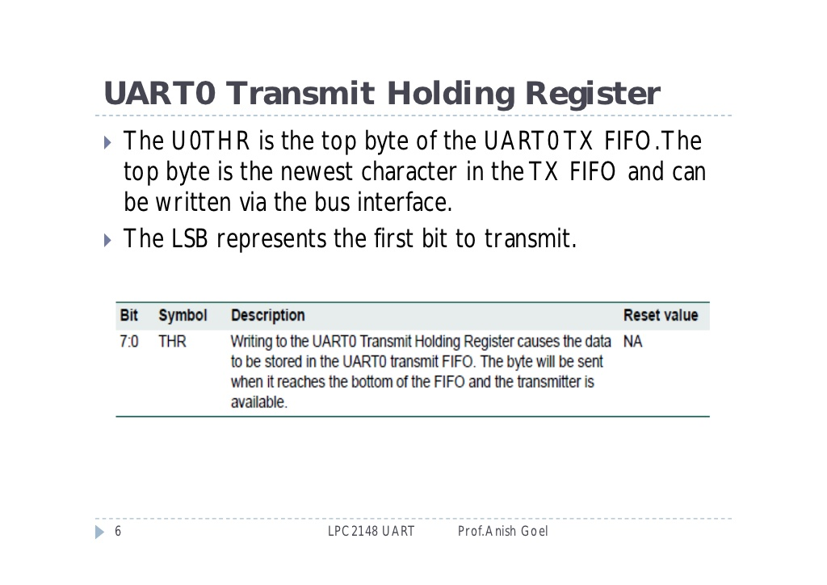

Slide 14
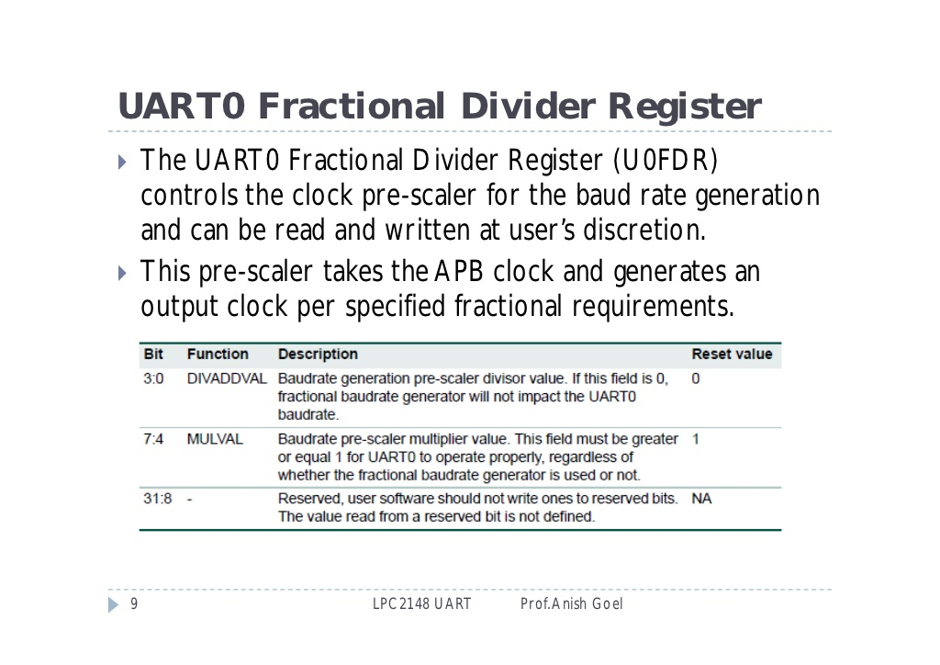

Slide 15
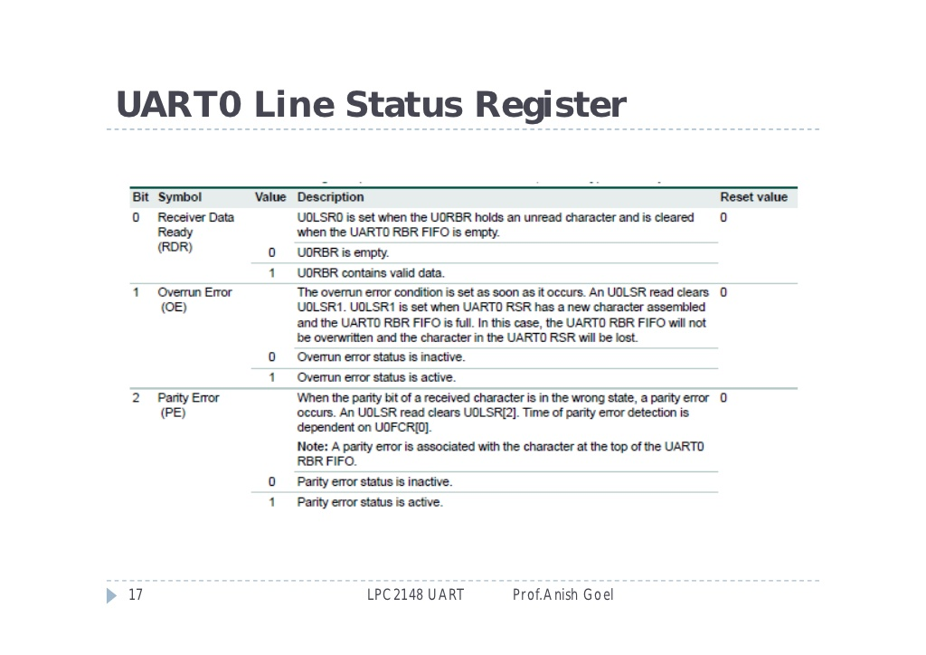

Slide 16
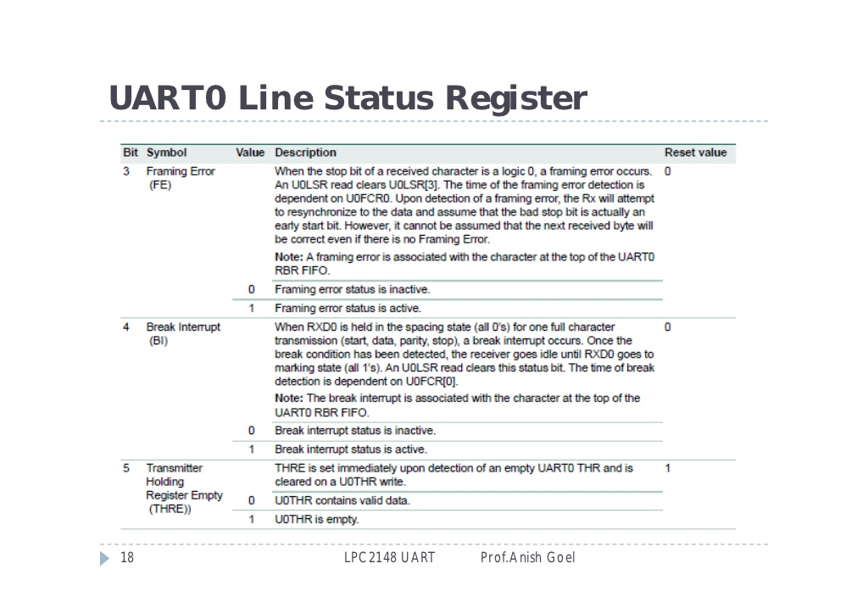

Slide 17
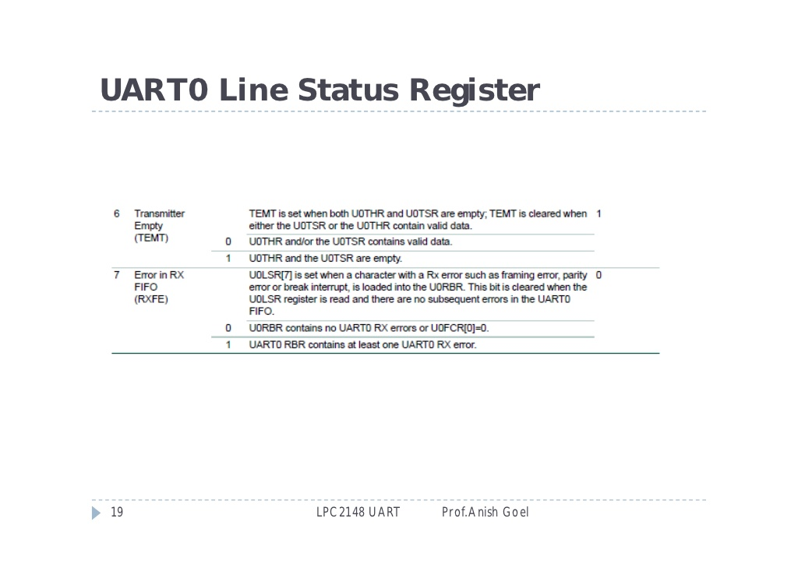

Slide 18
#include<LPC21xx.h>
void delay(void);
void serial(void);
unsigned char mg;
int main()
{
unsigned int i;
unsigned char msg[]={"BVB"};
serial();
while(1)
{
for(i=0;i<3;i++)
{
while(!(U0LSR & 0x20));
U0THR = msg[i];
}
while(!(U0LSR & 0x01));
mg=U0RBR;
U0THR=mg;
delay();
}
}

Slide 19
void serial()
{
PINSEL0 = 0x00000005;
U0LCR = 0x83;
U0DLL = 0x61;
U0LCR = 0x03;
}
void delay()
{
unsigned int i;
for(i=0;i<10000;i++);
}

